Slide 1
Tree ADT
atjahyanto@gmail.com

Slide 2
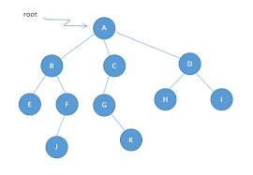
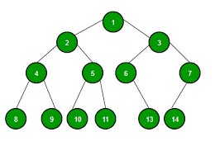
Tree
Non Binary Tree
Binary Tree

Slide 3
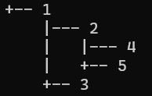
Binary Tree
class TreeNode {
int data;
TreeNode left;
TreeNode right;
public TreeNode(int data) {
this.data = data;
this.left = null;
this.right = null;
}
}
public class BinaryTreeDisplay {
public static void displayTree(TreeNode root, String prefix, boolean isLeft) {
if (root != null) {
System.out.println(prefix + (isLeft ? "|--- " : "+-- ") + root.data);
displayTree(root.left, prefix + (isLeft ? "| " : " "), true);
displayTree(root.right, prefix + (isLeft ? "| " : " "), false);
}
}
public static void main(String[] args) {
TreeNode root = new TreeNode(1);
root.left = new TreeNode(2);
root.right = new TreeNode(3);
root.left.left = new TreeNode(4);
root.left.right = new TreeNode(5);
displayTree(root, "", false);
}
}
BinaryTreeDisplay.java

Slide 4
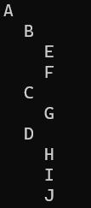
Non Binary Tree
import java.util.ArrayList;
import java.util.List;
class TreeNode {
String label;
List<TreeNode> children;
public TreeNode(String label) {
this.label = label;
this.children = new ArrayList<>();
}
}
public class NonBinaryTreeDisplay {
public static void displayTree(TreeNode node, String indent) {
if (node != null) {
System.out.println(indent + node.label);
for (TreeNode child : node.children) {
displayTree(child, indent + " ");
}
}
}
public static void main(String[] args) {
TreeNode root = new TreeNode("A");
root.children.add(new TreeNode("B"));
root.children.add(new TreeNode("C"));
root.children.add(new TreeNode("D"));
root.children.get(0).children.add(new TreeNode("E"));
root.children.get(0).children.add(new TreeNode("F"));
root.children.get(1).children.add(new TreeNode("G"));
root.children.get(2).children.add(new TreeNode("H"));
root.children.get(2).children.add(new TreeNode("I"));
root.children.get(2).children.add(new TreeNode("J"));
displayTree(root, "");
}
}
NonBinaryTreeDisplay.java

Slide 5
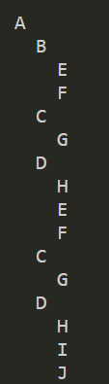
Implement Tree using List
import java.util.ArrayList;
import java.util.List;
class TreeNode {
String value;
List<TreeNode> children;
public TreeNode(String value) {
this.value = value;
this.children = new ArrayList<>();
}
public void addChild(TreeNode child) {
children.add(child);
}
}
class Tree {
private TreeNode root;
public TreeNode get_root() {
return root;
}
public Tree(String rootValue) {
this.root = new TreeNode(rootValue);
}
public void insertChild(TreeNode parent, String childValue) {
parent.addChild(new TreeNode(childValue));
}
public void printTree(TreeNode node, int level) {
System.out.println(" ".repeat(level) + node.value);
for (TreeNode child : node.children) {
printTree(child, level + 1);
}
}
}
public class PercobaanDua {
public static void main(String[] args) {
System.out.println("Hello, World!");
Tree tree = new Tree("A");
TreeNode rootNode = tree.get_root();
tree.insertChild(rootNode, "B");
tree.insertChild(rootNode, "C");
tree.insertChild(rootNode, "D");
tree.insertChild(rootNode.children.get(0), "E");
tree.insertChild(rootNode.children.get(0), "F");
tree.insertChild(rootNode.children.get(1), "G");
tree.insertChild(rootNode.children.get(2), "H");
tree.insertChild(rootNode.children.get(2), "I");
tree.insertChild(rootNode.children.get(2), "J");
tree.printTree(rootNode, 0);
}
}
PercobaanDua.java

Slide 6
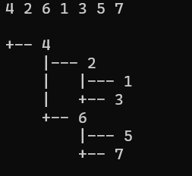
Tree Operation
class myBSTawal
{
// Class containing left and
// right child of current
// node and key value
class Node
{
int key;
Node left, right;
public Node(int item)
{
key = item;
left = right = null;
}
}
// Root of myBSTawal
Node root;
// Constructor
myBSTawal()
{
root = null;
}
// This method mainly
// calls insertRec()
private void insert(int key)
{
root = insertRec(root, key);
}
/* A recursive function to
insert a new key in myBST */
private Node insertRec(Node root, int key)
{
/* If the tree is empty,
return a new node */
if (root == null)
{
root = new Node(key);
return root;
}
/* Otherwise, recur
down the tree */
if (key < root.key)
root.left = insertRec(root.left, key);
else if (key > root.key)
root.right = insertRec(root.right, key);
/* return the root */
return root;
}
// A function to do
// inorder traversal of myBST
private void inorderRec(Node root)
{
if (root != null)
{
inorderRec(root.left);
System.out.print(root.key + " ");
inorderRec(root.right);
}
}
public void treeins(int arr[])
{
for(int i = 0; i < arr.length; i++)
{
insert(arr[i]);
}
}
public void displayTree(Node root, String prefix, boolean isLeft)
{
if (root != null) {
System.out.println(prefix + (isLeft ? "|--- " : "+-- ") + root.key);
displayTree(root.left, prefix + (isLeft ? "| " : " "), true);
displayTree(root.right, prefix + (isLeft ? "| " : " "), false);
}
}
public void printArray(int A[])
{
Integer x;
for (int i=0; i<A.length; i++) {
x = A[i];
System.out.print(x.toString()+' ');
}
System.out.println("\n");
}
// Driver Code
public static void main(String[] args)
{
myBST tree = new myBST();
int arr[] = {4,2,6,1,3,5,7};
tree.printArray(arr);
tree.treeins(arr);
tree.displayTree(tree.root, "", false);
}
}
Search
FindMin
FindMax
HeightTree / maxDepth
Insert
Remove
PreOrder
InOrder
PostOrder
private Node insertRec(Node root, int key)
{
/* If the tree is empty,
return a new node */
if (root == null)
{
root = new Node(key);
return root;
}
/* Otherwise, recur down the tree */
if (key < root.key)
root.left = insertRec(root.left, key);
else
if (key > root.key)
root.right = insertRec(root.right, key);
/* return the root */
return root;
}

Slide 7
Tree Operation
public int finMin(Node node)
{
Node current = node;
/* loop down to find the leftmost leaf */
while (current.left != null) {
current = current.left;
}
return (current.key);
}
public int maxDepth(Node node)
{
if (node == null)
return 0;
else {
/* compute the depth of each subtree */
int lDepth = maxDepth(node.left);
int rDepth = maxDepth(node.right);
/* use the larger one */
if (lDepth > rDepth)
return (lDepth + 1);
else
return (rDepth + 1);
}
}

Slide 8
Tree Operation
public void displayTree(Node root, String prefix, boolean isLeft)
{
if (root != null) {
System.out.println(prefix + (isLeft ? "|--- " : "+-- ") + root.key);
displayTree(root.left, prefix + (isLeft ? "| " : " "), true);
displayTree(root.right, prefix + (isLeft ? "| " : " "), false);
}
}
public void printPreorder(Node node)
{
if (node == null)
return;
// First print data of node
System.out.print(node.key + " ");
// Then recur on left subtree
printPreorder(node.left);
// Now recur on right subtree
printPreorder(node.right);
}

Slide 9
Tree Operation
public void printPostorder(Node node)
{
if (node == null)
return;
// First recur on left subtree
printPostorder(node.left);
// Then recur on right subtree
printPostorder(node.right);
// Now deal with the node
System.out.print(node.key + " ");
}
public void printInorder(Node node)
{
if (node == null)
return;
// First recur on left child
printInorder(node.left);
// Then print the data of node
System.out.print(node.key + " ");
// Now recur on right child
printInorder(node.right);
}

